Slide 1




JAYAWANT SHIKSHAN PRASARAK MANDAL’S Rajarshi Shahu College of Engineering (An Autonomous Institute affiliated to SPPU) Approved by AICTE, Accredited by NBA (UG Program) Accredited by NAAC with “A” Grade, MHRD-NIRF Rank: 201-250
Engineering Design and Development
A.Y. 2020-21
VIRTUAL DESKTOP ASSISTANT

Slide 2
Project Report VIRTUAL desktop assistant
Group Members:
TEAM LEADER: IT086 - SANKET KANEGAONKAR
IT071 - SHUBHAM ARAKH
Mentor :Prof. Mehzabin Shaikh mam
IT102 - NITESH JADHAV
IT124 - KIRAN LANDGE
IT075 - DHRUV KANOJIA

Slide 3
INTRODUCTION
In today’s era almost all tasks are digitalized. We have Smartphone in hands and it is nothing less than having world at your finger tips. These days we aren’t even using fingers. We just speak of the task and it is done. That is the task of a Virtual Assistant
Virtual Assistants are software programs that help you ease your day to day tasks, such as showing weather report, creating reminders, making shopping lists etc.
They can take commands via text (online chat bots) or by voice. Voice based intelligent assistants need an invoking word or wake word to activate the listener, followed by the command

Slide 4


Slide 5
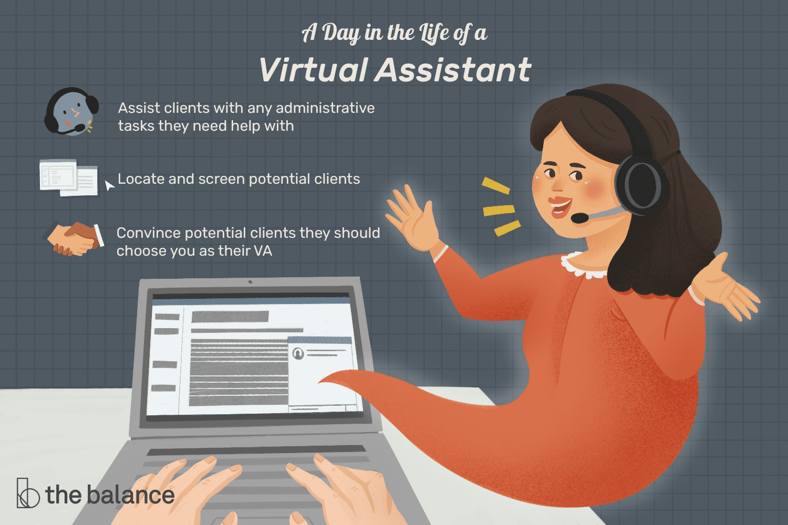

Slide 6
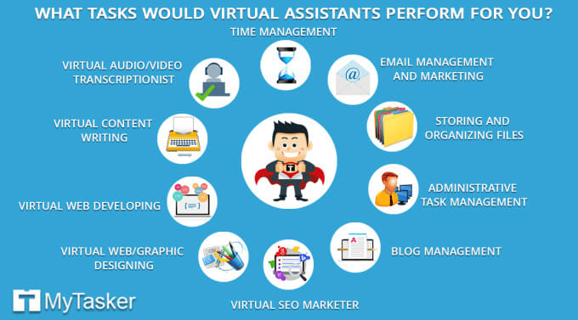

Slide 7
PROBLEM STATEMENT
Artificial intelligence personal Assistants have become plentiful over the last few years. Applications such as Siri, Alexa, Google and Cortona are few examples which make mobile device users daily routines that much easier which we can’t imagine. You might be asking yourself how these functions. Well, the assistant receives external data such as movement, voice, GPS reading, e.t.c via the hardware sensors ( which we are using) for further processing and take it from there to function accordingly.

Slide 8
PROBLEM STATEMENT
To create a simple personal AI Assistant, one simply needs dedicated software and around an hour of working time. It would take much more time, tough, to create something more advanced and conceptually innovative.

Slide 9
SCOPE
Our main objective of building personal assistant software ( a virtual assistant) is to answer question that are asked by users.
Virtual assistant can tremendously save your time. We spend hours in online research and then making the report in our terms of understanding, VIRTUAL ASSISTANT can do that for you.
One of the main advantages of voice searches is their rapidity. In fact, voice is reputed to be four times faster than a written search. Our VA can perform several task like giving user weather report, send e-mail, set alarm, language converting, daily news update and many more by just giving command to virtual assistant and it will do the work you command him.

Slide 10
REQUIREMENT
Personal assistant software is required to act ass an interface into the digital world by understanding user requests or commands and then translating into actions or recommendations based on agent’s understanding of the world.
SOFTWARE:
Windows 7(32bit) or above
Python 2.7 or later
Python modules
Chrome driver
HTML/CSS

Slide 11
DESCRIPTION
A virtual assistant is a self-employed worker who specializes in offering administrative services to clients from a remote location, usually a home office.
Typical tasks a virtual assistant might perform include scheduling appointments, making phone calls, making travel arrangements and managing email accounts.
Some virtual assistants specialize in offering graphic design, blog writing, book-keeping, social media and marketing services.
For an employer, one advantage of hiring a virtual assistant is the flexibility to contract for just the services they need.

Slide 12
ADVANTAGES OF VIRTUAL ASSISTANT:-
Reduced labour costs:- Virtual assistants work as independent contractors. This means they handle all their own expenses, including taxes and insurance.
Increased productivity:- Virtual assistants work differently. Without the distractions of an office environment, they’re able to focus and dedicate their time to getting tasks done.
Increased flexibility:- If you’re in different time zones, that can work to your advantage, too. Rather than assigning eight-hour shifts, you can develop a schedule that maximizes output while keeping costs in check.

Slide 13
ADVANTAGES OF VIRTUAL ASSISTANT:-
Improved work quality:- How much more productive could you be if someone was there to handle all those nonessential tasks for you? Then you’d be able to dedicate more time to growing and marketing your business.
Reduced risk in scaling operations:- Rather than taking on new employees, hiring a VA would help you manage your work volume without breaking your budget.
Skills your business needs:- Whether your business is large or small, it’s unlikely that you and your staff have every single skill you need to run it.

Slide 14
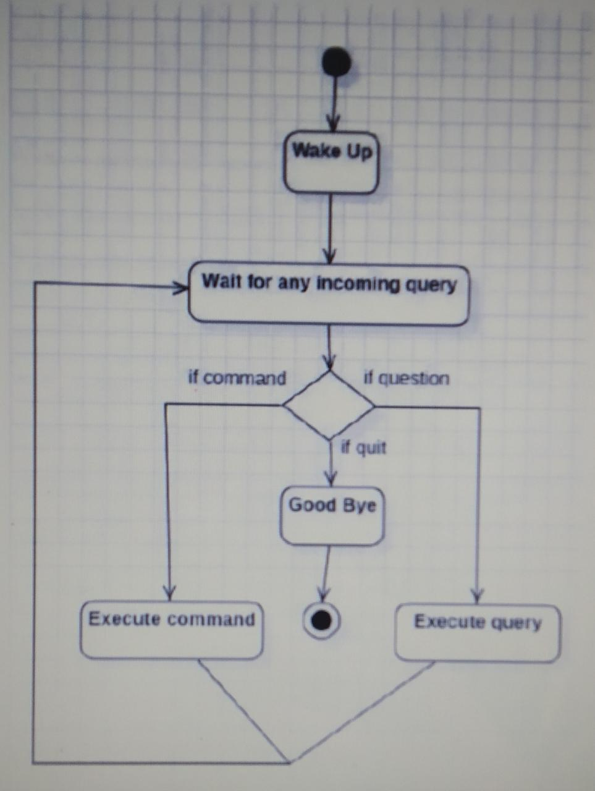
ACTIVITY DIAGRAM:-

Slide 15
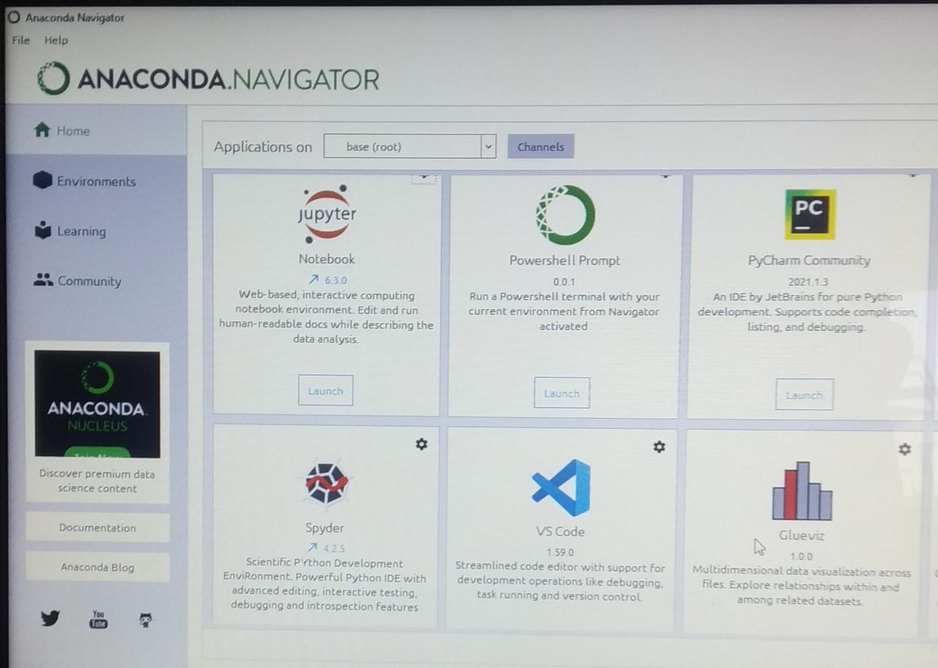
SOFTWARE & HARDWARE REQUIRED
1.] Jupyter-
The Jupyter Notebook is an open source web application that you can use to create and share documents
2.] Anaconda-
Anaconda is a distribution of the Python and R programming languages for scientific computing that aims to simplify package management and deployment.
3] Python[3.8] –
Python is an interpreted high-level general-purpose programming language.

Slide 16
Some modules used:-
pyttsx3: pyttsx is a cross-platform text to speech library which is platform independent. The major advantage of using this library for text-to-speech conversion is that it works offline.
SpeechRecognition: It allow us to convert audio into text for further processing.
webbrowser: It provides a high-level interface which allows displaying Web-based documents to users.
Wikipedia: It is used to fetch a variety of information from the Wikipedia website.
os: The OS module in Python provides functions for interacting with the operating system. OS comes under Python's standard utility modules. This module provides a portable way of using operating system dependent functionality.
Playsound: the playsound module contains only a single function named playsound(). It works with both WAV and MP3 files.
gTTS: gTTS is a very easy to use tool which converts the text entered, into audio which can be saved as a mp3 file
Image:The Import Image option allows you to add an image file. Add a company logo or other bitmap image in order to customize output for presentations and reports.

Slide 17
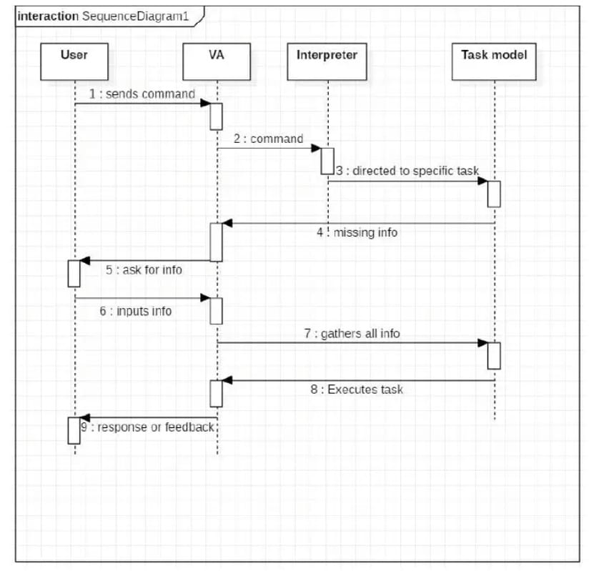
EXECUTION DIAGRAM:-

Slide 18
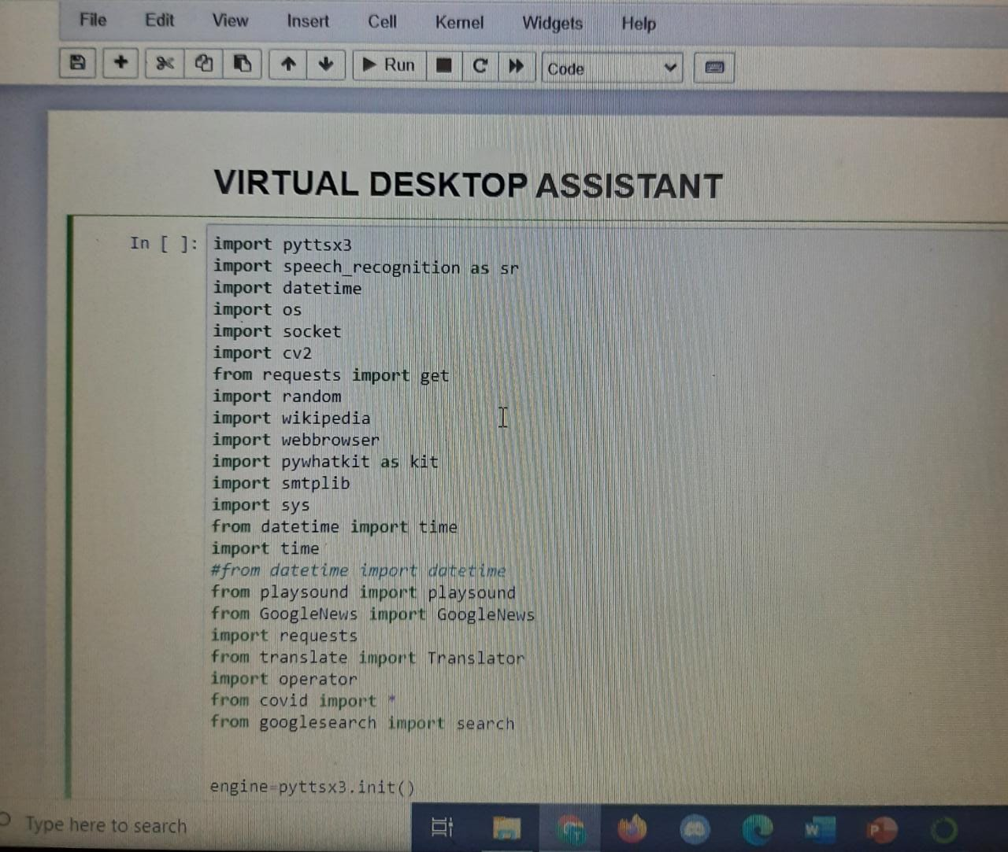
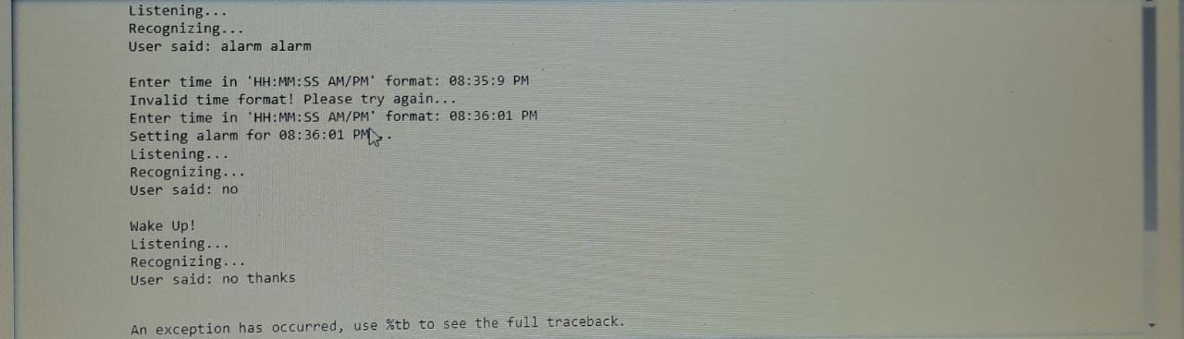
Result:-

Slide 19
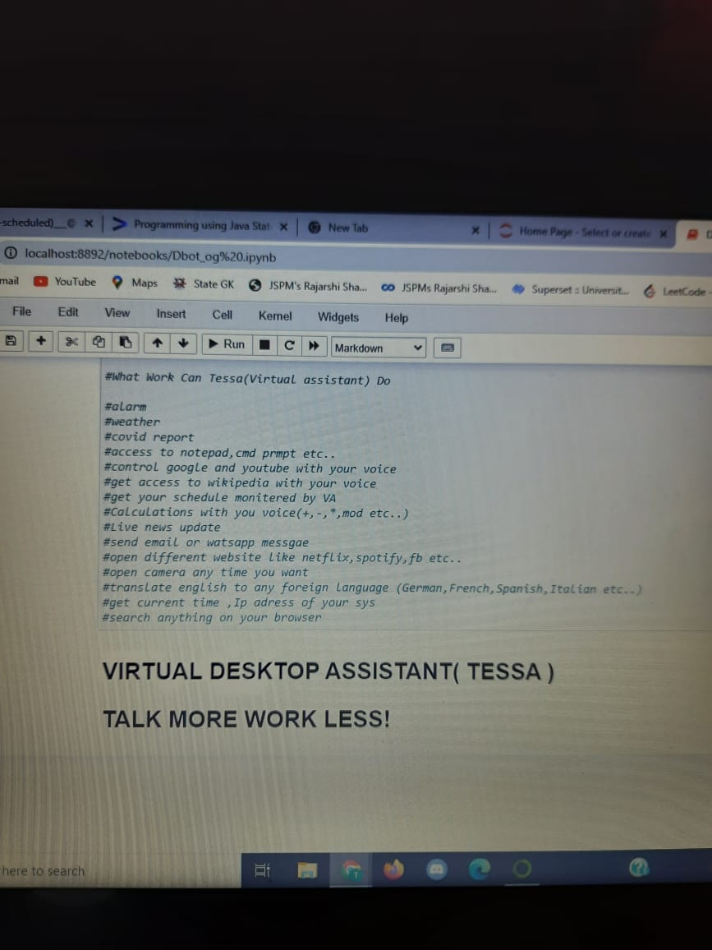
Work that can be done by tessa

Slide 20
THANK YOU

